Slide 1
SC2002 SCE3 Group 3

Slide 2
UML Class Diagram

Slide 3
UML Sequence Diagram

Slide 4
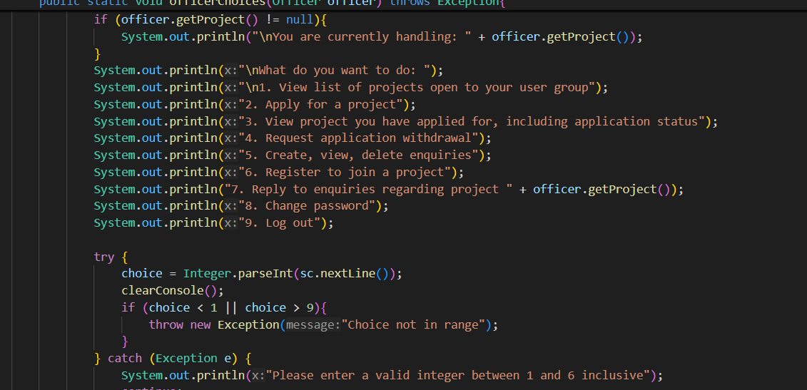
Design Consideration
Before the professor taught on SOLID principles, nested if else try statements made the code harder and harder to work on as time progressed

Slide 5
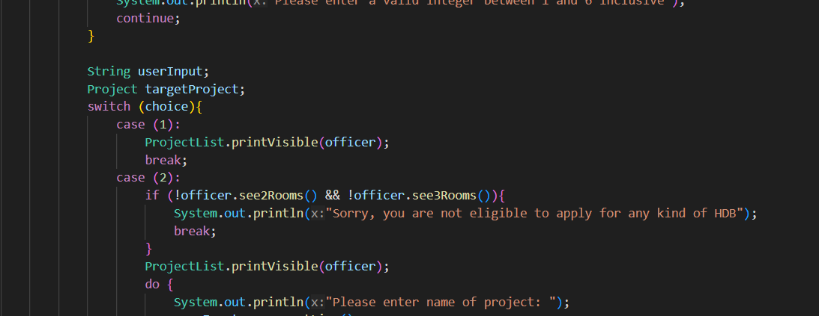
Design Consideration
Case statements made it time consuming to read through code and adjust a lot of bounds when new features added

Slide 6
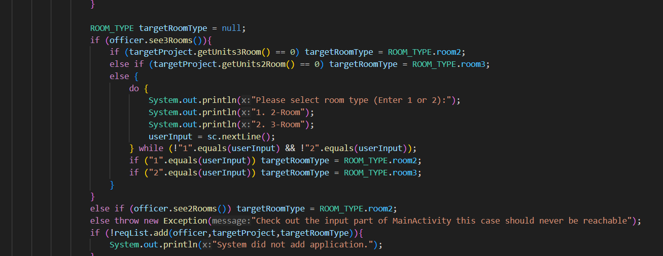
Design Consideration
Took a significant amount of time editing the Main class print and input cases compared to the implementation of the code

Slide 7
Extra features: password Hashing, Salt, Pepper

Slide 8
Extra features: Menu Stack features, for deeper nesting, if required.

Slide 9
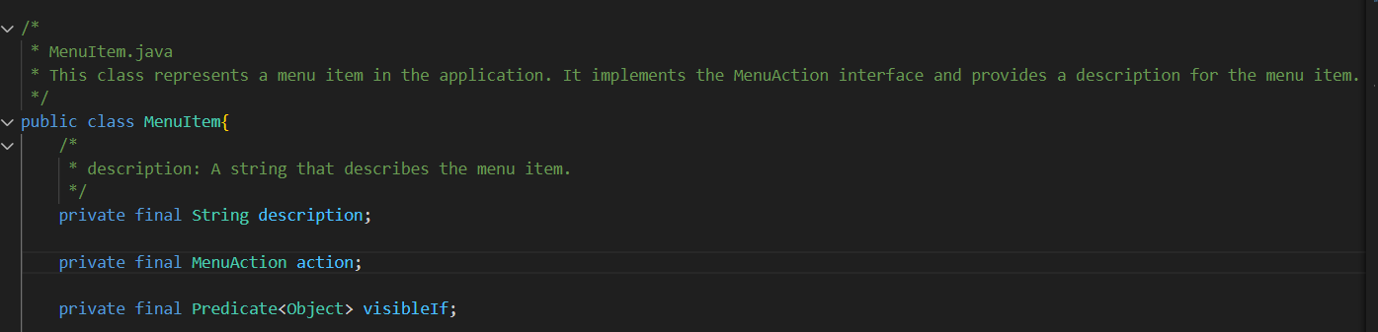
Extra features: Command Pattern
Reason: Easier to initiate

Slide 10
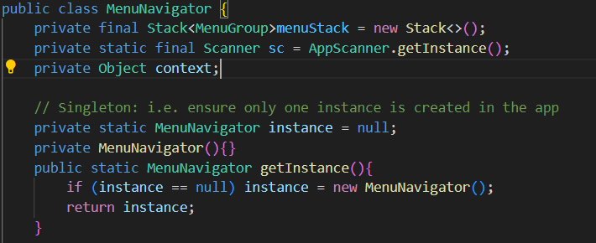
Extra features: Singleton
Reason: Some classes should have 1 global object only

Slide 11
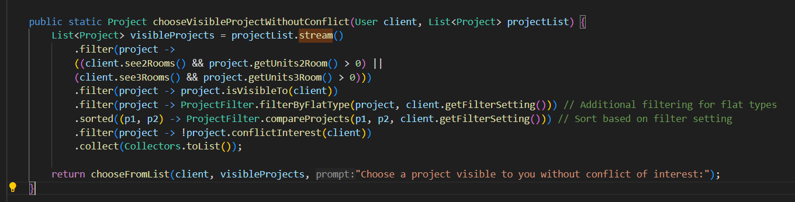
Extra features: Pipeline Pattern
Reason: streams API naturally leads to using pipeline pattern

Slide 12
Extra features: Model-View-Controller Pattern
Reason: AssignReq+ AssignReqList (Controller)
officerAssignIO (View)
Officer, projects (Model)
Similar parallels for Enquiries, and Housing Applications
3x Model View Controller patterns in this case

Slide 13
Implementation Code

Slide 14
Demonstration and Report

